Slide 1
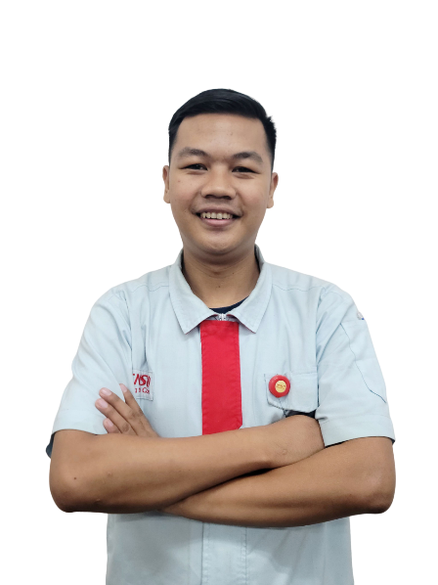
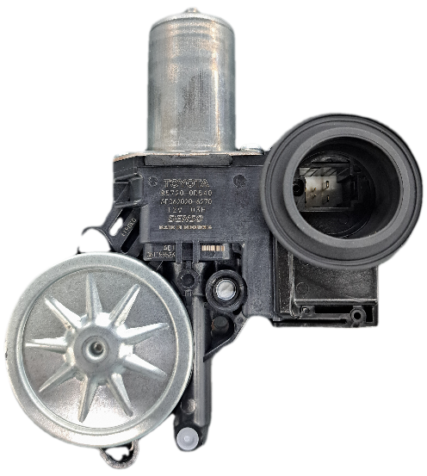
Final Presentation
KOSEN PROGRAM
Name : Alvany Maulana
NIK : DM2260925
Line : BF 23 Power Window
Assy Line 2
Background : SMK NEGERI 1 KATAPANG
Major : MECHATRONICS ENGINEERING
Motto : Believe that anything is possible
Content :
Introduction
Schedule activity
Layout line & Process Condition
OJT Activity & Skill in Production line
Case Study
Commitment & Future Plan
Notes:
Assalamualaikum Wr.Wb, Good Morning Everyone I’m Alvany Maulana From BF23 Power Window Assy
I will explain about my final presentation during the OJT with the motto : BELIEVE THAT ANYTHING IS POSSIBLE

Slide 2








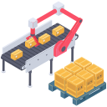






➀
My Profile
2/16
A. Education
C. Matrix Skill at DNIA
KOSEN Denso Manufacturing Indonesia
Polytechnic STMI Jakarta
Manufacturing Process
SMK Negeri 1 Katapang (Bandung)
Mechatronics Engineering
D1 Polytechnic STMI Jakarta
IELTS Band 5.5
JLPT N5
B. Training Lesson
Basic Web Programming
TIE Basic
SWC Type 1 & 3
AVERAGE SCORE IS 86.6
MIFC
Level | Detail
Level 1 | Carry out standard operations
Level 2 | Perform according to standard
Level 3 | Able to find problems
Level 4 | Take action and improvement
Process In Line
Kaizen Activity
D. Certification
D1 Polytechnic STMI Jakarta
IELTS Band 5.5
JLPT N5
Basic Mentality & Leadership (RMBS)
BNSP Mechanical Inspection
BNSP Equipment Maintenance
Basic Mentality & Leadership (RMBS)
BNSP Mechanical Inspection
BNSP Equipment Maintenance
Motto :
Stay Hungry For Success
Notes:
FIRST, this is my profile
Start from my education, I school from vocational high school 1 katapang bandung with my major is mechatronics engineering

Slide 3
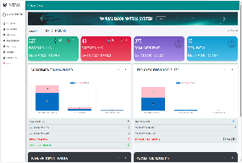
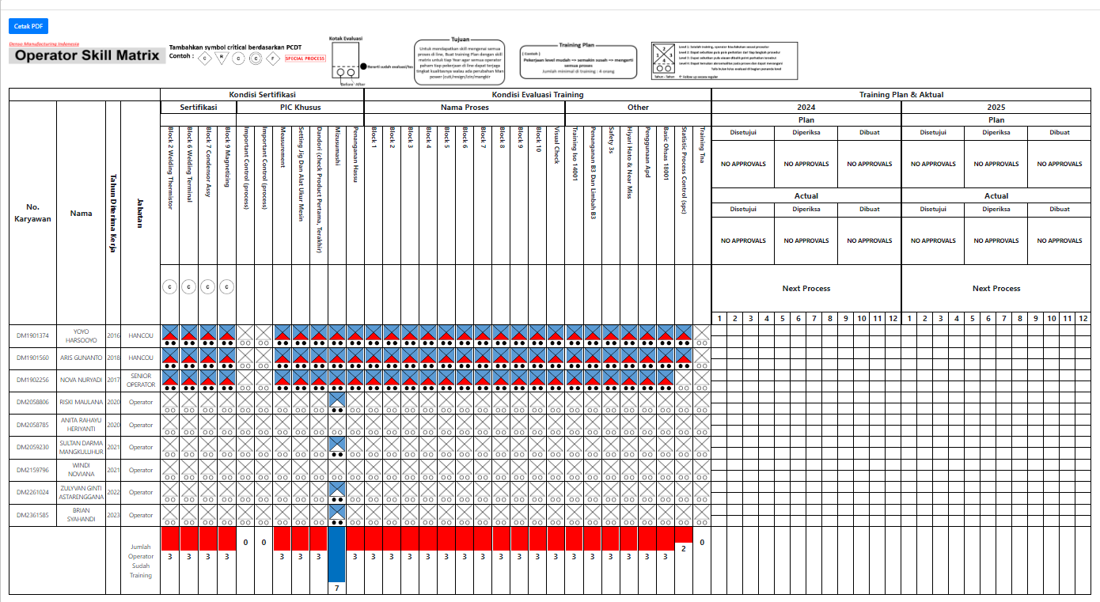
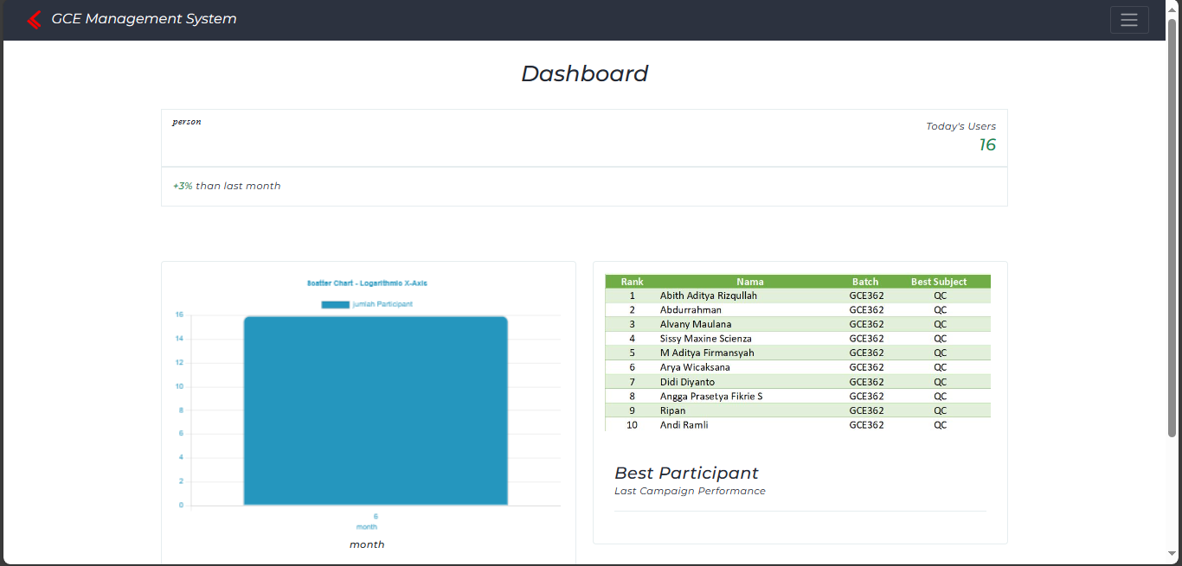
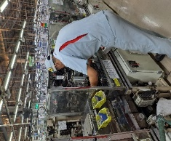
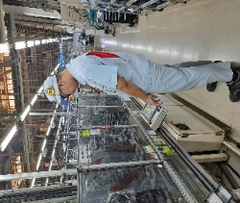
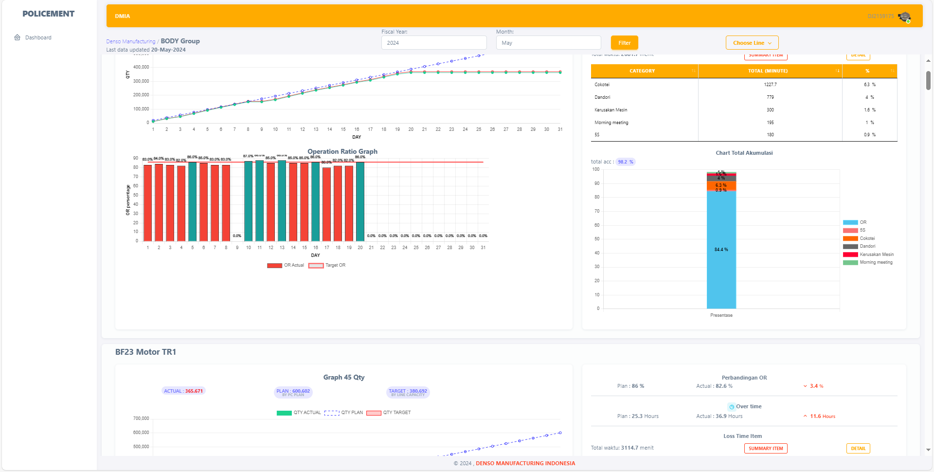
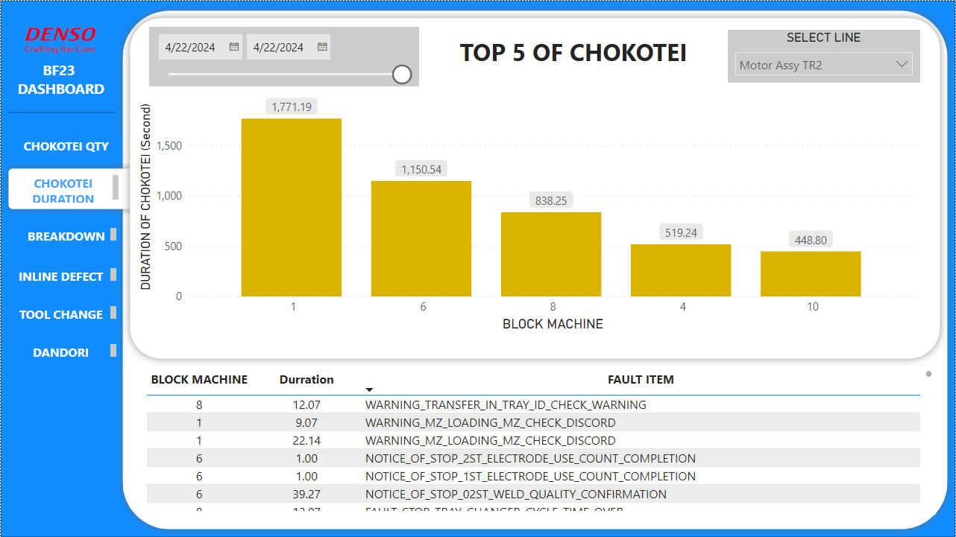
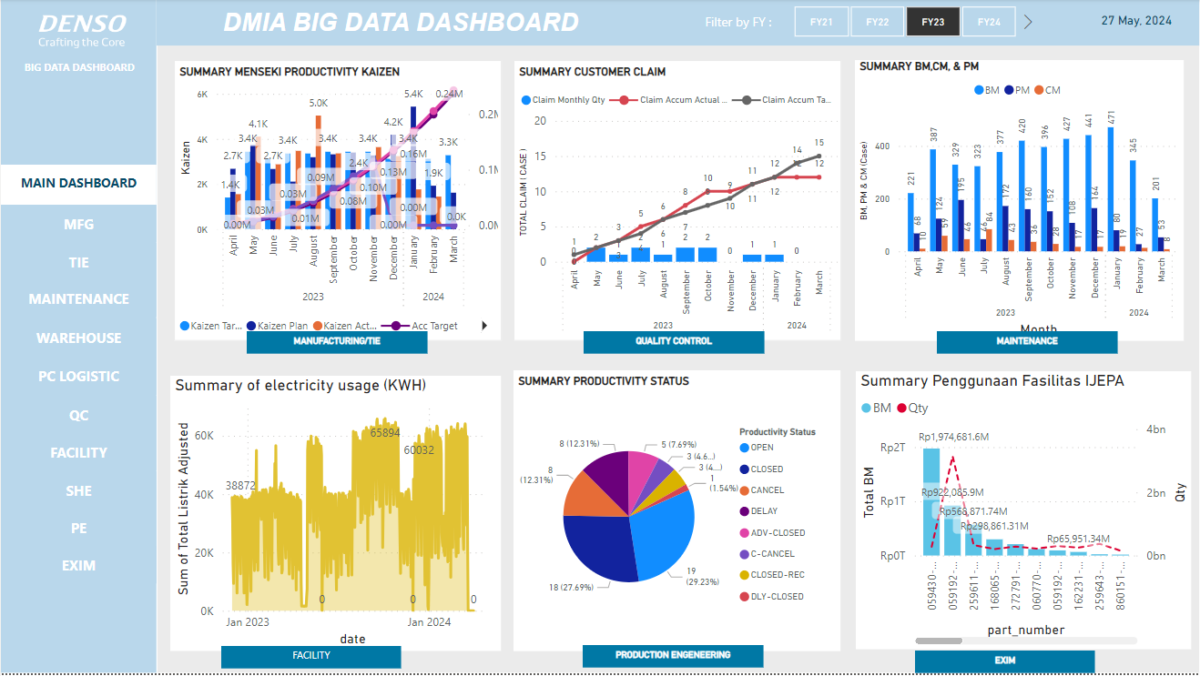
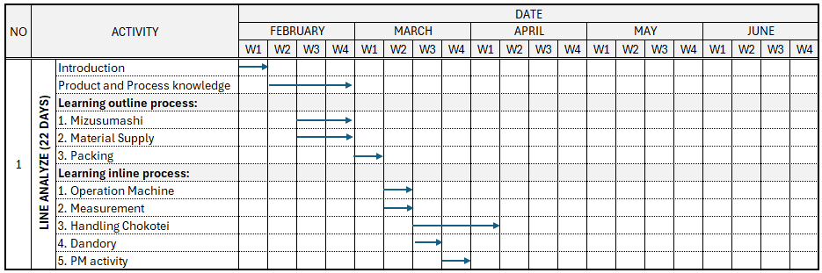
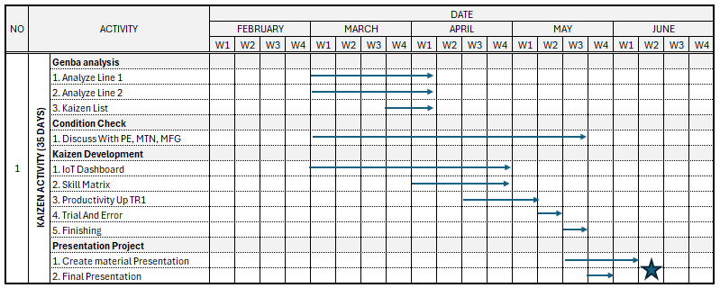
➁ Schedule Activity
3/16
Training In DNIA
Dojou Training
DX
TIE
BF23
BF23 Project
Jul’22 – Jun’23
Jul’23
Aug – Dec’23
Jan’24
Feb’24 – Mar’24
Apr’24 – May’24
In class and out class training (learn about soft skill and hard skill
5 days training (learn about Basic Manufacturing in DMIA
Project digitalization and visualization
Learn about Basic TIE (SWC,MIFC, productivity)
Make SWC type 1,3 and MIFC in line BF23
Learn about knowledge BF23 ( inline and outline), process, measurement, PM
Genba Project, digitalization, visualization
KCA Radiator Line 5
Karakuri
Creative Engineering
Training system for DOJOU,HR Section
16 atarimae
5 budaya keselamatan
5 quality commitment
MATRAS System
TIE System Productivity Achievement each line
Visualization KPI All section DMIA
GCE Management System
Training system for TRE Section
BIG DATA visualization
POLICEMENT System
➂ Schedule Activity BF23
35 Work Days
22 Work Days
2 years of study has brought achievement, growth, and new understanding
Notes:
Next is my Activity schedule for 2 years.
Start from Training at DNIA last year until OJT at genba is around 60 days at BF23
And this is detail activity at BF23 start from learning knowledge until kaizen activity.

Slide 4
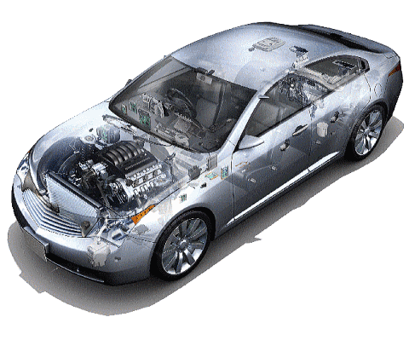
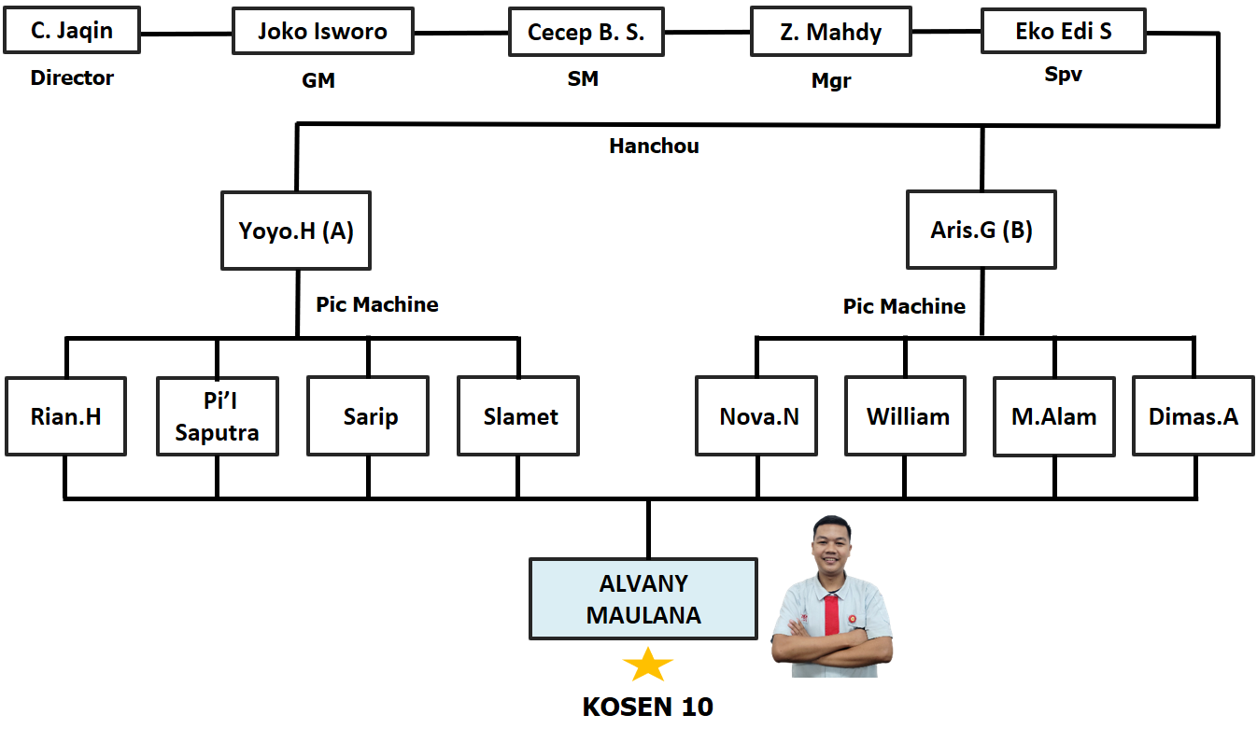
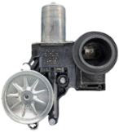
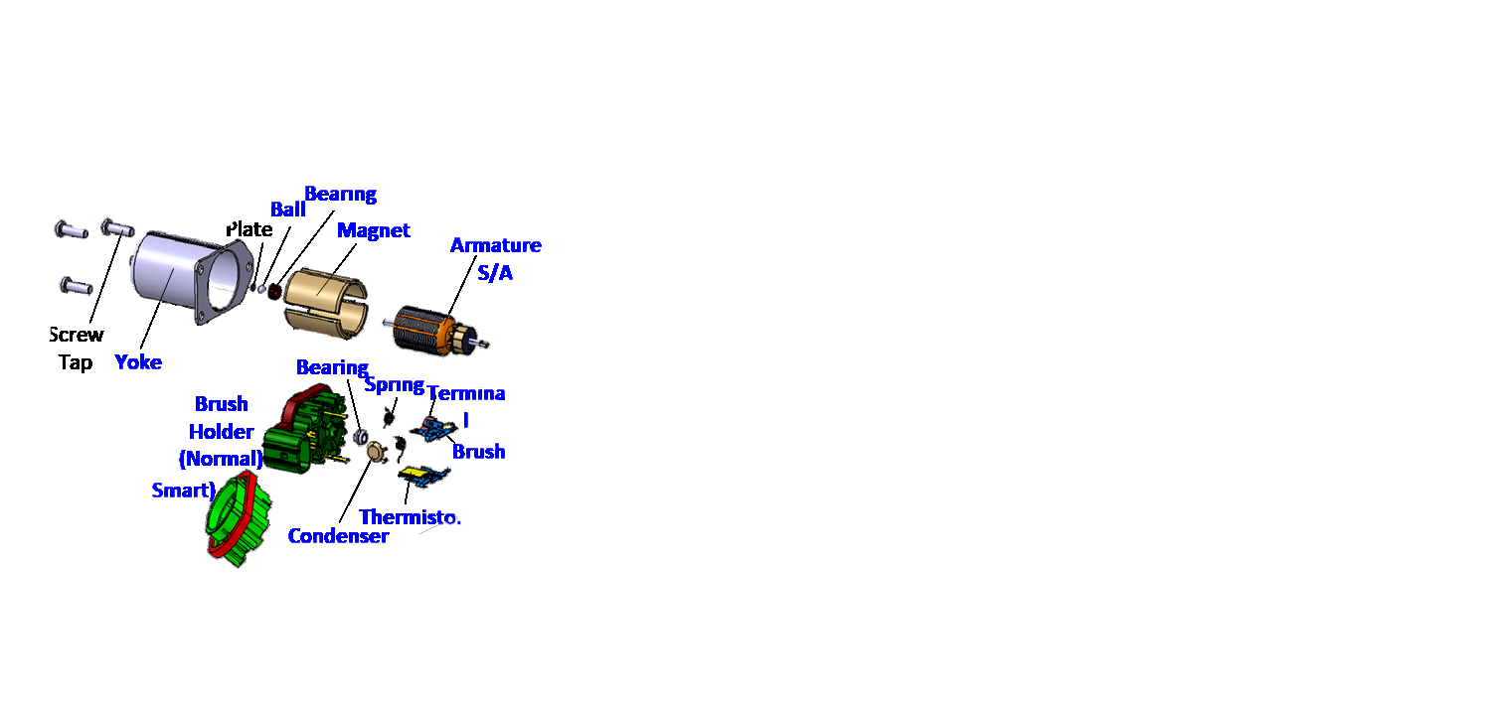
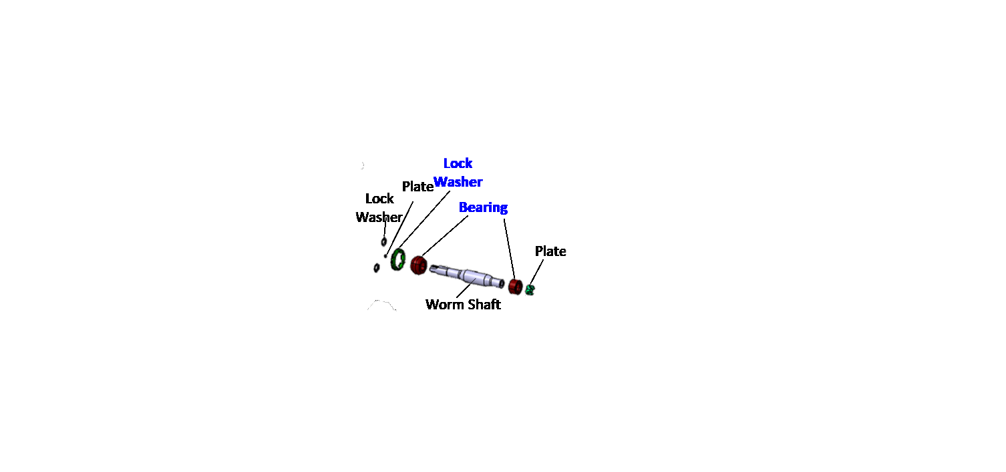
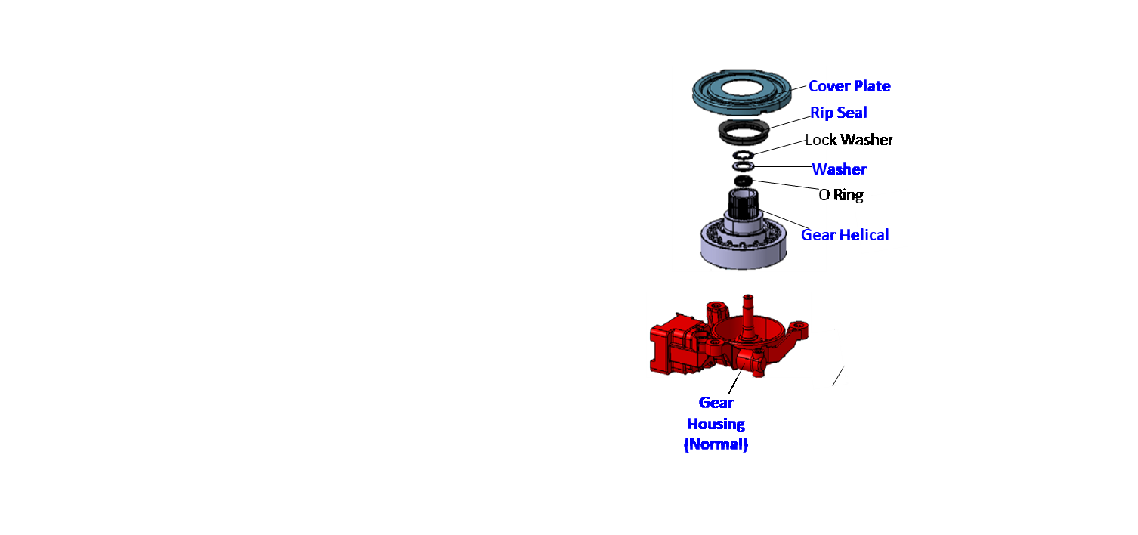
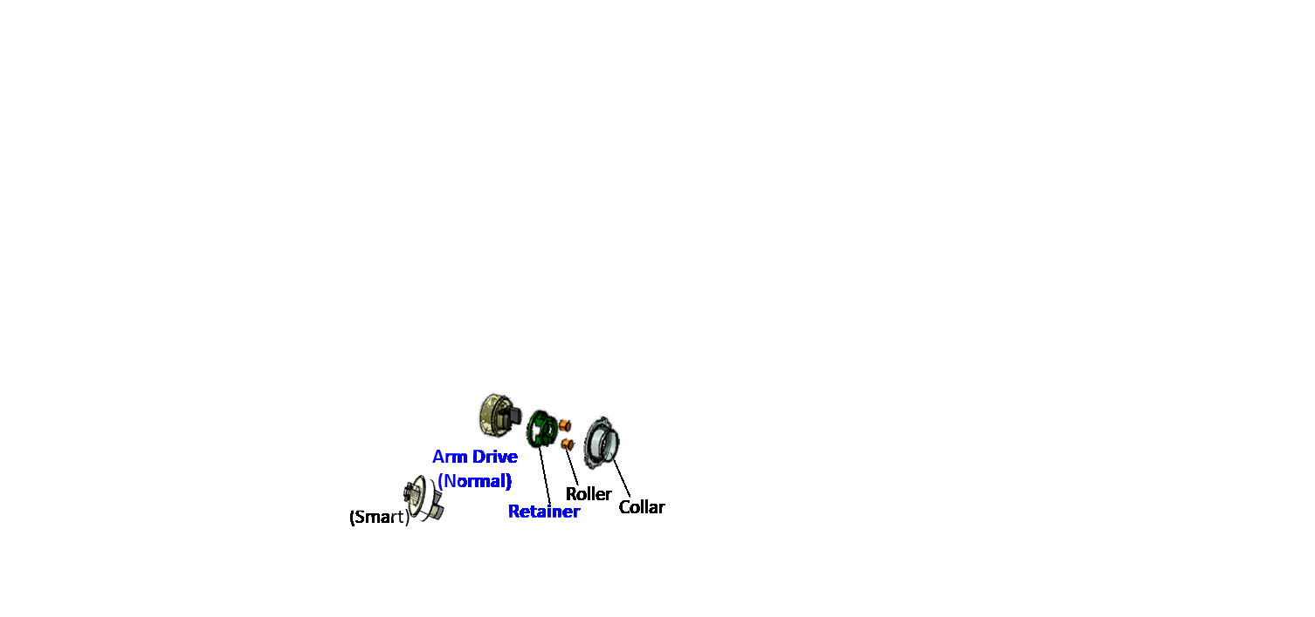
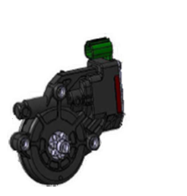
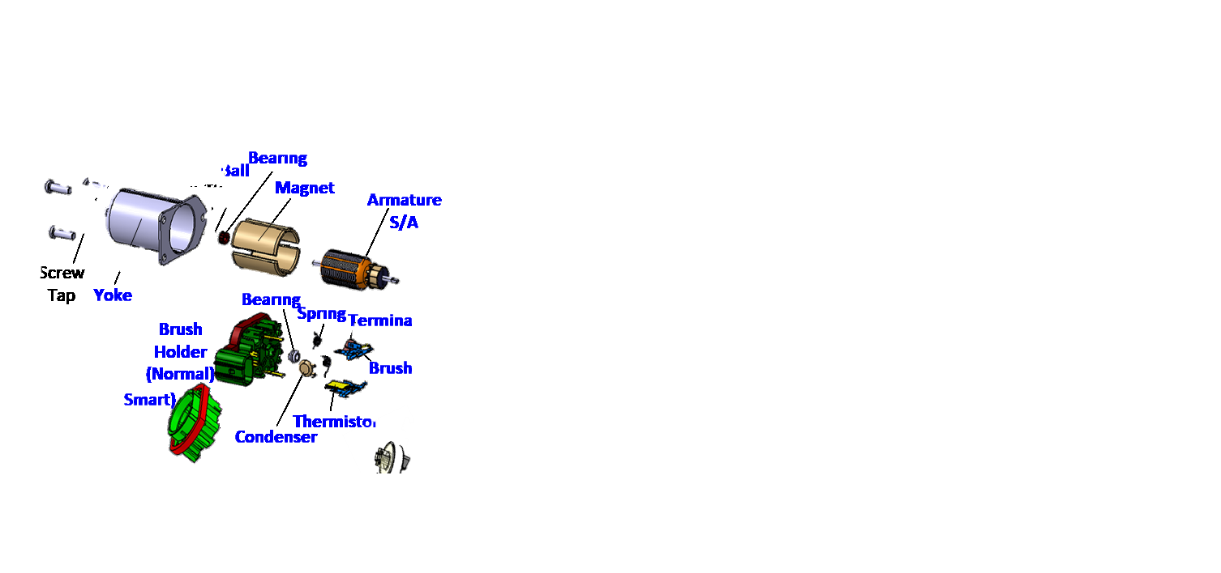

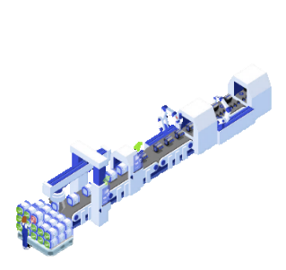
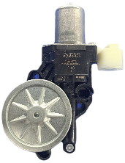
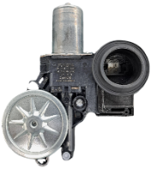
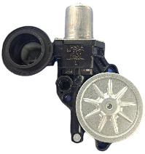
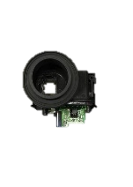

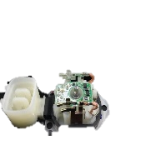
➃ Product Knowledge
4/16
A. Organization Structure BF23 TR 2
BF23 Power Window
system is to open and close windows electrically using switches. The motor rotates when the switch is pressed. The rotation of the power window motor will change up or down through the regulator.
BF23 Power Window has 3 models product. Normal, Sensor, and Smart model,
For Line 1 running product Sensor and Smart.
For Line 2 only running product BF23 Normal model.
Motor S/A
Housing S/A
Main Assy
B. Product Knowledge
Housing
S/A
Motor
S/A
Transfer line
A transfer line is an automated system of connected machines or workstations used to sequentially process or assemble a product.
BF23 is one of the lines in DMIA that already use transfer lines. Actually as a Transfer line, BF-23 has 2 lines with a fast cycle time (2.7s)
Inspection
Smart model
Sensor
SMART
Normal
BF23 Power Window
Sensor Model
BF23 Is Transfer line Has 3 Models (Normal, Sensor, Smart) with 2.7 Cycle time
Notes:
Move to the other slide, product knowledge BF23.
Start from structure organization and Me in here!
As we know bf23 is transfer line that has 2 line with 3 models power window. There is normal, sensor and smart and this is the material to make a power window

Slide 5

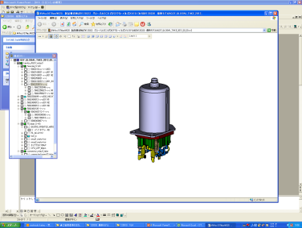
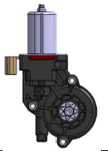
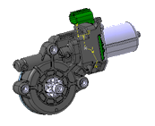
➄ Layout Line and Process BF23 TR2
5/16
CT = 2.7 Second
Flow Process
Focus Learned at MOTOR S/A
Motor SA Line
Housing SA Line
B-1
B-2
B-3
B-4
B-5
B-6
B-7
B-8
B-9
B-10
Terminal & Thermistor Assy
Motor SA Line
B-1
B-2
B-3
B-4
B-5
B-6
Housing Supply & Plate Assy
PIC Machine
Flow
Thermistor Welding
B-10 | B-9 | B-8 | B-7 | B-6 | B-5 | B-4 | B-3 | B-2 | B-1
Brush Carbon Supply
Shaft worm, Bearing, Lock washer Assy
Holder brush Supply
Gear supply & greasing
C
C
Bearing P/F & Brush Carbon Assy
C
C
Visual Check
Mizusumashi 1
Mizusumashi 2
Welding Terminal & cutting
Rubber, Plate end, Shaft drive, & O ring Assy
Condensor Assy & Resistance check
C-Ring Assy & Greasing
Housing SA Line
Arm Assy & Stator Assy
Flow
Mizusumashi
Housing Supply
Centering & Resistance check
Buthil & Cover Caulking
B-1 | B-2 | B-3 | B-4 | B-5 | B-6
Conveyor System
Motor S/A
Housing S/A
PIC Machine
C
Focused in line MOTOR S/A for OJT to get knowledge about process, measurement, PM, Mizusumashi, etc.
Main Assy Line
Main Assy Line
Inspection Line
PIC Machine
B-1
B-2
B-3
B-4
B-5
B-6
B-7
B-8
Housing SA Supply, Collar & Push nut Assy
B-1
B-2
B-3
B-4
B-5
B-6
B-7
B-8
Power Window Assy Supply
B-8 | B-7 | B-6 | B-5 | B-4 | B-3 | B-2 | B-1
Tokusei 1(Performance check)
Arm Drive supply
C
Housing SA Supply
Retainer Assy & Greasing
Tokusei 2(Performance check)
Conveyor System
Mizusumashi
C
C
Motor S/A Supply
Tokusei 3(Performance check)
Inspection Line
PIC Machine
Grease, Plate & Clutch grease
Tokusei 4(Performance check)
Same Process (5Stations)
Screw tightening & screw check
Tokusei 5(Performance check)
B-1 | B-2 | B-3 | B-4 | B-5 | B-6 | B-7 | B-8
Atsumore (leak Test)
Visual Check
&Packing
Injection Molding
Pipe Ventilation Assy & Laser Marking
Motor Supply
C
C
C
C
C
Laser Marking
Power Window BF23 F/G
Power Window Assy
During OJT at BF23, I Focused learning the process on MOTOR S/A TR2
Notes:
And as we can see this is layout line at BF23 TR2 with CT 2.7. During OJT at BF23 i focused learning process at MOTOR S/A line 2

Slide 6
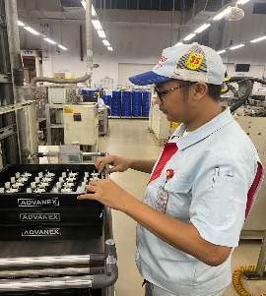
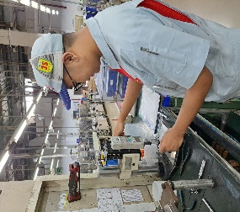
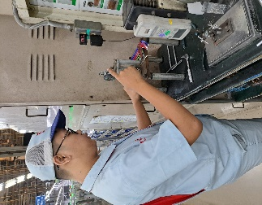
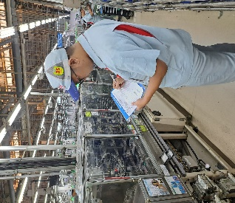
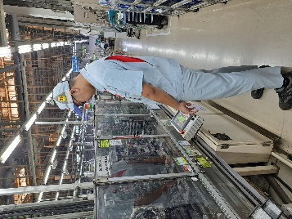
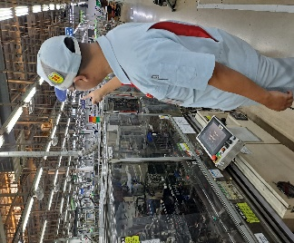

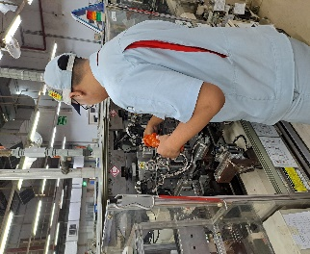
➅ OJT BF-23 Motor S/A TR2
6/16
On Job Training Activities
Understanding of product BF23
rules of working on production line.
(Model, material, function, etc.)
Understanding the work system in the production line.
(input production plan, supply material at machine, Mizusumashi, etc.)
Mizusumashi
Measurement
Understanding process of machine (Safety, quality).
How to Running machine (Preparation)
Check safety at machine
input daily check sheet
Take measurement and tool change
Handle chokotei with the supervision of the leader.
PM Activity
Setting Electrode
Input Check sheet
Operation Machine
Handling Chokotei
Change Electrode
PM Activity
Important to get understanding Production line to achieve the goals as future leader
Notes:
Then, this is my ojt activity at BF23 Motor TR2
First understanding about product of BF23
Second about production line or work aystem
The last about process of machine
so very important to get understanding production line to achive goals as future leader.

Slide 7
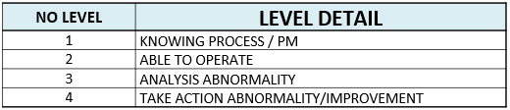
➆ Skill in production line MOTOR S/A TR2
7/16
BEFORE
AFTER
List Chokotei That I can Handle MOTOR S/A LINE
MACHINE NO |  | CHOKOTEI LIST
BLOCK 1 | 1 | Bus Bar L Supply Cycle Time Over
 | 2 | Bus Bar R Supply Cycle Time Over
 | 3 | 1st Shuttle 2 Bus Bar L Supply Fault
 | 4 | 2st Shuttle 1 Bus Bar R Supply Fault
 | 5 | 3st Cycle Time Over
 | 6 | 3st Excision Part Supply Fault
 | 7 | 03st C V Excision Memory Discord Fault
 | 8 | 3st Before Camera Part Supply Fault
 | 9 | Magazine Changer Cycle Time Over
BLOCK 2 | 1 | Thermister Welding 1 No Work Before Welding Fault
 | 2 | Electrode 1 Use Times Full
 | 3 | Thermister Welding 2 No Work Before Welding Fault
 | 4 | Electrode 2 Use Times Full
BLOCK 3 | 1 | Pig Tail Caulking Check Camera 1 Ng
 | 2 | Brush L Loading Brush Turn No Work Fault
 | 3 | Brush R Loading Brush Turn No Work Fault
 | 4 | 04st Terminal R Miring
 | 5 | Brush S A L Discharging No Work On Pallet Fault
 | 6 | Brush S A R Discharging No Work On Pallet Fault
BLOCK 4 | 1 | Circulation R Side Parts Existence Fault
 | 2 | Circulation L Side Parts Existence Fault
 | 3 | Xr Robot Cycle Time Over
 | 4 | Brush Holder Loading Image Check Iv1 Ng Fault
BLOCK 5 | 1 | Image Check L Side Consecutive Ng
 | 2 | 3st Cycle Time Over
 | 3 | Image Check R Side Consecutive Ng
 | 4 | 2st Cycle Time Over
BLOCK 6 | 1 | Palette Top Non Work
 | 2 | Electrode Use Count Completion
BLOCK 7 | 1 | Cycle Stop Condensor Supply Fault
 | 2 | 2st Supply Part Cycle Time Over
BLOCK 8 | 1 | Fault Stop Xr Robot Cycle Time Over
 | 2 | Cycle Stop Brush Drawing Fault
 | 3 | Cycle Stop Shuttle 1 Work Fault
BLOCK 9 | 1 | Fault Stop Xr Robot Cycle Time Over
 | 2 | Cycle Stop Positioining Tray Id Communication Fault
 | 3 | Cycle Stop Shuttle 2 Work Fault
BLOCK 10 | 1 | Cycle Stop Sp R Pushing After Unusual Work
 | 2 | Cycle Stop Sp L Pushing After Unusual Work
 | 3 | Cycle Stop Centering Consecutive Ng
 | 4 | Fault Stop Tray Changer Cycle Time Over
Measurement MOTOR S/A LINE
I Understand about in line process and outline process at MOTOR S/A
Notes:
And this is detail my skill at motor S/A line tr2 start from measurement skill mizusumashi, PM, until a lot of chokotei that I can handle.. So its amazing right?

Slide 8
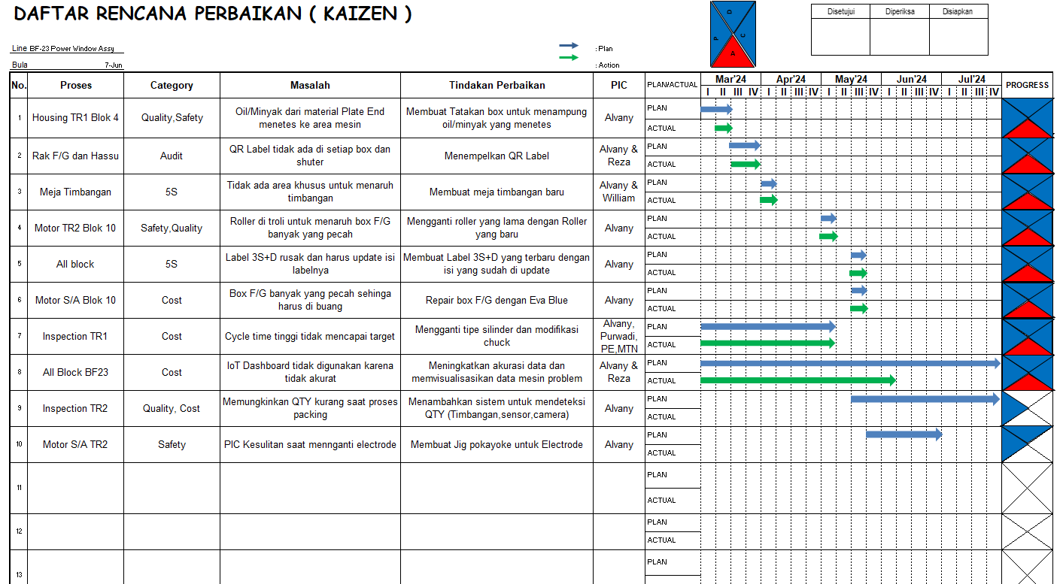
➇ Kaizen Plan Sheet
8/16
I have 10 kaizen in BF23 and 2 kaizen I will present
Notes:
Next this is my kaizen plan sheet at bf23, and I have ten kaizen and 2 kaizen I will present

Slide 9




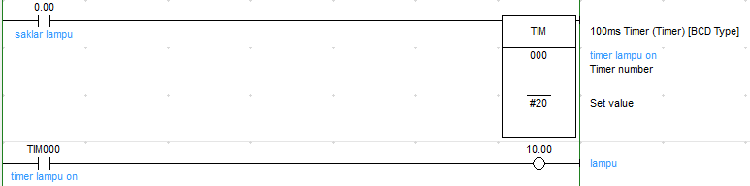
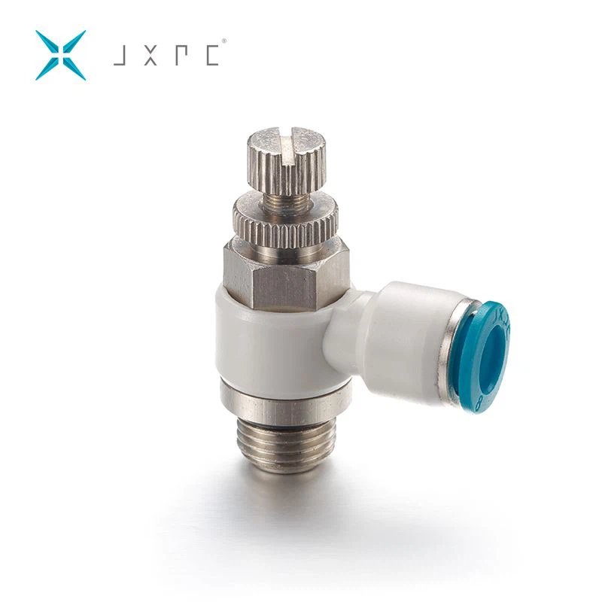

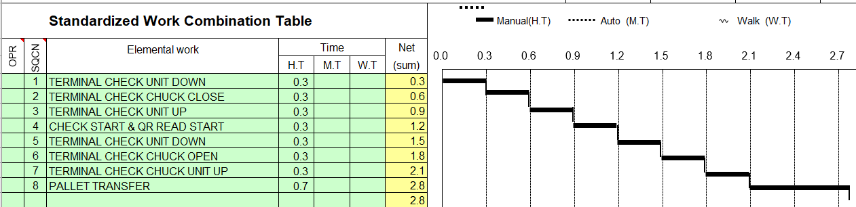
➈ CASE STUDY 1 : PRODUCTIVITY IMPROVEMENT
9/16
WAY OF THINGKING
Detail Process M/C Block 8 :
STANDARDIZING CYCLE TIME FOR OUTPUT STABILITY
IN SHIFTER
BLADE CHECK
CN. SA L ASSY
CN. SA R ASSY
CN. SA CHECK
2.8 sec
TRANSFER (MAIN)
CN. SA SUPPLY
TERMINAL CHECK/QR
CN. SA DISCHARGE
TRAY CHANGER
CURRENT CONDITION
BF 23 TR 1 Cycle Time (Sec)
Motor Assy | Housing | Main Assy | Inspection
2.7 | 2.7 | 2.7
2.8
POSSIBLE TO IMPROVE BECAUSE CT=2.8 SECOND
PLAN SCHEDULE
ANALYZE BLOCK 8
Activity | PIC | MARCH |  |  |  | APRIL |  |  |  | MAY
 |  | I | II | III | IV | I | II | III | IV | I | II | III | IV
Genba Analysis | MFG
Problem Analysis | MFG
Discussion | MFG, PE
Redesign | PE
Order Supplier | PE
Setting PLC | MTN
Test Running | MFG,PE,MTN
Monitoring | MFG,PE,MTN
ANALYZE 1 : HIGH Timer in PLC
ACTION : Try Changing the TIMER PLC from 0.5 second to 0.2 second
RESULT :
STILL NOT ACHIEVE TARGET CT OVER
ANALYZE 2 : Throttle Control
ACTION : Try Changing the Throttle Control
RESULT :
STILL NOT ACHIEVE TARGET CT OVER
Set to FULL So that the CYLINDER movement is FAST
#50
#20
ACTION
For Eliminate 2 elemental work in process “TERMINAL CHECK / QR”
MUST BE:
CHANGE type of cylinder and CREATE custom CHUCK
Analyze sequence process terminal TERMINAL CHECK/QR.
1 TERMINAL CHECK UNIT DOWN 0.3 0.3
THERE ARE 2 MUDA PROCESSES THAT POSSIBLE TO IMPROVE IN TERMNAL CHECK
SPEED LOSS AROUND 0.5 SECOND
7 TERMINAL CHECK UNIT UP 0.3 2.1
Over cycle time causes a decrease in productivity
Notes:
NEXT case study 1 about productivity improvement.
The way of thinking is Standardizing Cycle time for output stability
Look at the current condition on the first line of BF23
As we can see CT inspection line is 2.8s and more high than the others line
We can see together the yamazumi inspect line 1 the bottleneck in block 8
And this is detail machine process block 8. process terminal check is possible to improve compared to others.
After that I have plan schedule during this project.
First activity is analyze block number eight.
Here I do 2 analysis, first change the TIMER PLC and then change the throttle control speed. But still NOT achive the target CT.
Last action is analyze sequence process terminal check.
As we can see speed loss is around 0.5 sec
So WHAT WE DO?
Change type of cylinder and create custom chuck

Slide 10
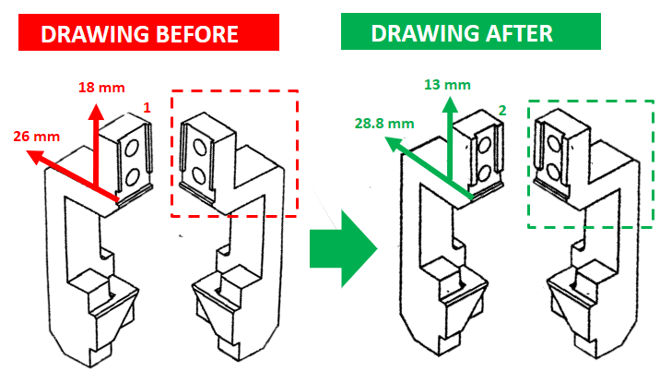
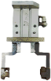
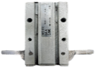
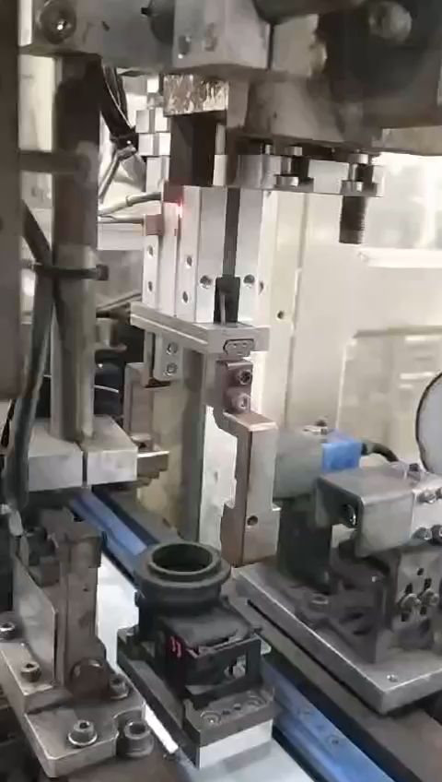
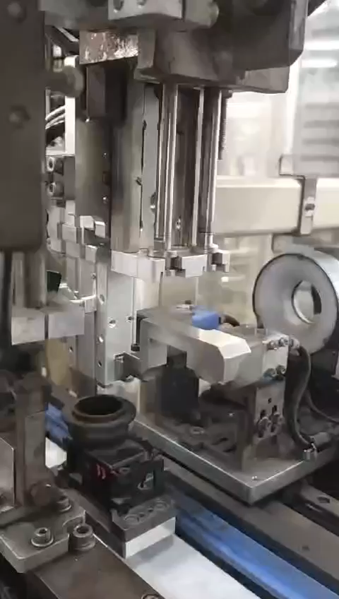
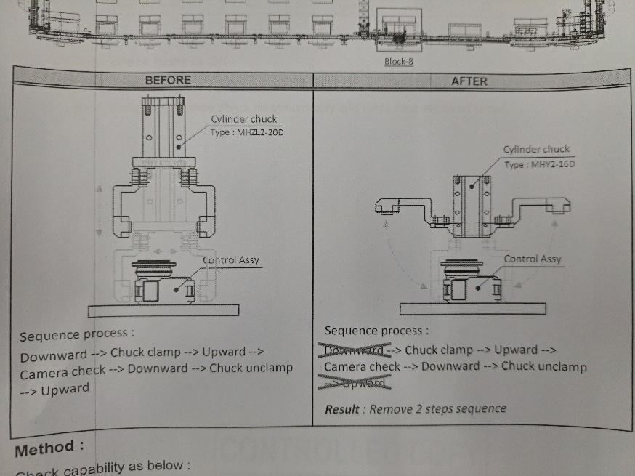
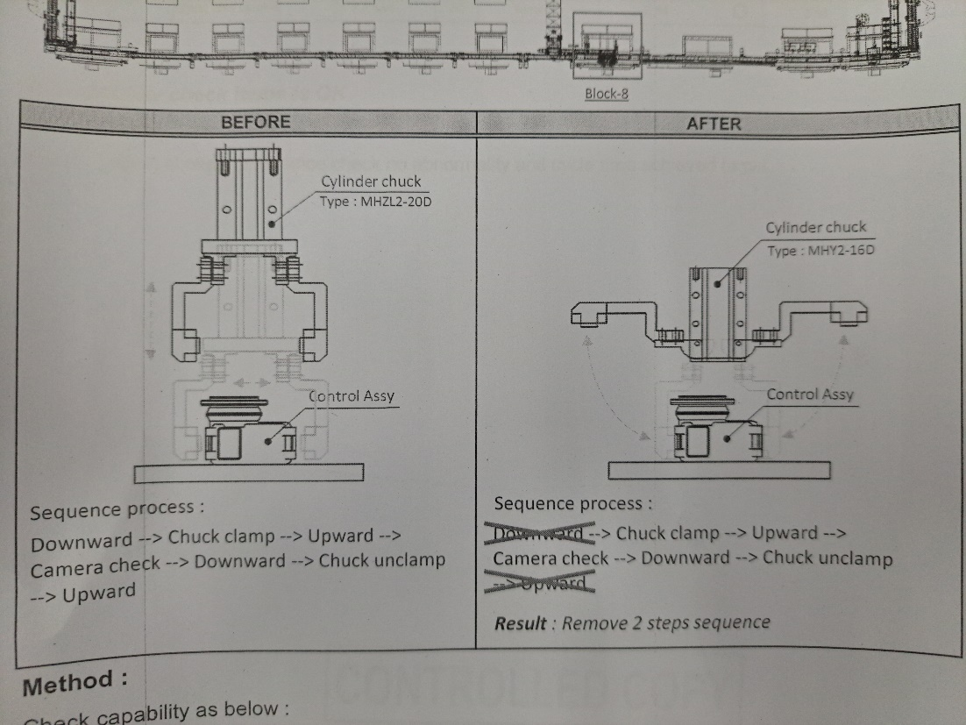
➈ CASE STUDY 1 : PRODUCTIVITY IMPROVEMENT
10/16
IMPLEMENTATION
The chuck models are the same, but there are differences in terms of dimensions and type of cylinder that used.
TYPE OF CYLINDER
BEFORE
AFTER
BEFORE
AFTER
Change type of cylinder and modify the chuck to achieve Cycle time target
Notes:
This is implementation the project.
This is drawing chuck and this is type of cylinder that used.
The chuck models are the same but there are differences in terms of dimensions.
This is video implementation, chuck movement changes from like this to like this

Slide 11

➈ CASE STUDY 1 : PRODUCTIVITY IMPROVEMENT
11/16
RESULT
PRODUCTIVITY UP AFTER KAIZEN
New Sequence process TERMINAL CHECK/QR
Total work time / day ➔ 3600s x 10 hour = 36.000 second
Total output / day :
CT = 2.65 Second
Cycle time line 2.8 sec
Cycle time line 2.7 sec
36.000s : 2.8s = 10.928 pcs
36,000 : 2.7s = 11.333 pcs
Total output loss :
Succeeded in eliminating from 8 processes to 6 processes
11,333 – 10,928 = 405 pcs
405 pcs x 2 shift = 810 pcs
810 pcs x 30 days = 24.300 pcs
2.7 sec
2.7s
Productivity UP
405 pcs
x
=
3.57%
=
100%
30k
25K
20K
0
11.333 pcs
Output / day
After kaizen we increase 24.300 pcs per month and productivity up 3.57%
3.57%
Motor | Housing | Main Assy | Inspection
2.7 | 2.7 | 2.7
BF 23 PW ASSY TR 1 Cycle Time (Sec) After Kaizen
23K
21K
2.7
BEFORE
AFTER
Increases productivity 3.57% and profitable around 2.4 billion per month
Notes:
This is result after implementation
After kaizen cycle time down to 2.7 second and output production increase by around twenty four thousand pcs per month and productivity up 3.57 percent

Slide 12






➉ CASE STUDY 2 : IOT DASHBOARD IMPLEMENTATION
12/16
Way Of Thinking
Schedule Activity
IoT Dashboard is a good system to visualize data from machine.
Activity | PIC | March |  |  |  | April |  |  |  | May
 |  | I | II | III | IV | I | II | III | IV | I | II | III | IV
Problem 1 : Unknown Loss Data
1. Unknown loss Analysis | KOSEN
2. Discuss with DX Team | KOSEN, MFG, DX
3. Discuss with Bitmaker | KOSEN, MFG, DX, Vendor
4. Development IoT | Vendor
5. Trial And Error | KOSEN
6. Monitoring | KOSEN
Problem 2 : No Summary Data
1. Discuss with DX Team | KOSEN, DX
2. Discuss with SPV BF23 | KOSEN, MFG
3. Development | KOSEN
4. Trial and Error | KOSEN, MFG
5. Monitoring | KOSEN
OPERATION RATIO
DEFECT
CHOKOTEI
DANDORY
Until Now NOT USED PROPERLY
Because in IoT Dashboard :
High percentage unknown loss and data chokotei less than 1 percent/day
There is No Summary to analyze
Problem 1 : Unknown Loss Data
Problem Analysis
TRIGGER TO RECORD
START RECORD
END RECORD
Some handling Chokotei “Master ON” must be True
MASTER
ON
X
MASTER
ON
MASTER
ON
IoT Dashboard is a good system to visualize data from machine.
Visualize real-time and accurate data from machine
Auto alert (Notification) of Tools & Material Change, for fast action from MFG/MTN
Store data > 1 year
Integrate to the production control system, which aims to eliminate manual input
Notification of Chokotei (True) + Master ON (False)
Notification of Chokotei (false) + Master ON (True)
What We Do?
Data IoT DOES NOT MATCH with Actual Genba
Discuss with MAINTENANCE About memory PLC in actual machines
Create chokotei handling pattern discuss with PIC Line
Machine is having problem
Some Problem data is not recorded in IoT
LOW Chokotei data & HIGH Unknown data
TRIGGER TO RECORD DATA IS WRONG
Data IoT Dashboard not used properly because the data not match with actual genba
Notes:
OK, Next case study two about IOT DASHBOARD IMPLEMENTATION
This is way of thinking
IoT Dashboard is a good system to visualize data from machine.
But Currently BF23 has IoT but it is not used properly
Why is not used properly?
There is 2 problems.
high percentage of unknown loss and Data chokotei from IoT less than 1 percent
There is no summary to analyze
And this is my schedule activity doing this project
Therefore let me analyze the problem.
Problem 1 : Unknown loss data
As we can see my analysis on 04 march 2024
In IoT, unknown loss more than seventeen percent, but actual motor less than 8% so this is the problem.
Current condition, machine is having problem but some data is not record in IOT and the result Low chokotei data and high unknown data.
So HOW IOT record the data?
The trigger that used before in IoT is master on but on my opinion it is WRONG
Because some handling chokotei master on must be true.
So WHAT WE DO?
Disscuss with MTN, and create chokotei handling pattern

Slide 13


➉ CASE STUDY 2 : IOT DASHBOARD IMPLEMENTATION
13/16
Problem 1 : Unknown Loss Data
Chokotei and Breakdown Pattern
ACTION
Pattern 1
Machine condition :
Alarm on + fault notification → Master ON (Off) → Auto Operate Off
Machine condition :
Alarm on + fault notification → Master ON → Auto Operate Off
Machine condition :
3. Alarm on + fault notification → Master ON → Auto Operate ON
CHANGE TRIGGER IOT TO RECORD PROBLEM
START RECORD :
2 Triggers to Start Record Chokotei/Breakdown :
Fault Notification
Signal Tower R (CIO2015.11) == True / (ANDON LAMP RED= ON)
2 Triggers to Finish Record Chokotei/Breakdown:
Fault Notification Reset
Signal Tower G (CIO2015.13) == True / (ANDON LAMP GREEN= ON)
MASTER
ON
AUTO
START
Pattern 2
MASTER
ON
AUTO
START
END RECORD :
Pattern 3
MASTER
ON
AUTO
START
Using ANDON LAMP as New Trigger to record data chokotei.
Because of the pattern above :
If Machine Problem,
RED ANDON light must be ON
If Machine Running,
GREEN ANDON light must be ON
Can’t Use all of button in monitor machine such as MASTER ON and AUTO START as Chokotei recording TRIGGER
Andon Lamp is the best trigger to record data chokotei.
Notes:
This is the detail pattern of chokotei.
There are 3 pattern to handle chokotei
After knowing the pattern, We change the trigger to record the data chokotei. USED ANDON RED for start and ANDON GREEN stop record.

Slide 14





➉ CASE STUDY 2 : IOT DASHBOARD IMPLEMENTATION
14/16
IMPLEMENTATION PROBLEM 1
Data Chokotei – 27 May 2024
RESULT WITH ANDON TRIGGER
IoT Dashboard Graph Comparation
Duration (s)
Duration (s)
17% Unknown data
>1% Chokotei data
OR often low below target
>1% Unknown data
6% Chokotei data
OR Achieve target
Unknown loss data less than 1% and Data Accuracy Chokotei Increases up to 95%
ANALYSIS WHY NOT 100%
PROBLEM
Each block has a chokotei type (Cycle Time Over) and set timer 20 second in PLC before alarm
0.5% percent chokotei per day is CYCLE TIME OVER
Usually PIC line finish handle this chokotei before alarm ON
Block Data and type of chokotei is the same with actual
There is data has not been recorded properly, the chokotei is “CYCLE TIME OVER”
20 SECOND is standard for “CYCLE TIME OVER” from DEPT. PE
x
NEXT ACTIVITY
Discuss with PE Department To change the standard CYCLE TIME OVER in BF23 line
CYCLE TIME OVER CONDITION
The Machine and Process have stopped
Notification and ANDON RED ON
20s
5.4s
2x CT
Delay 20 Seconds
Success eliminate unknown loss
Notes:
This is Implementation with new trigger using andon lamp
After analyze, most of data is the same.
This is IoT dashboard graph comparation on march and may 2024.
In conclusion, currently unknown loss data less than 1 percent and the data accuracy chokotei increases up to 95%.
But WHYY NOT 100%?
After analyze again when monitoring
There is data chokotei has not been recorded.,
The case is CYCLE TIME OVER, because andon red on after delay 20 second
usually before alarm chokotei ON, PIC already done handle the chokotei.
FYI 20 second is standard timer CYCLE TIME OVER FROM PE DEPT.
And I think, next activity must be ask to department PE to disscuss about the problem.
The next action is change standard CTO in BF23 line from 20 second to 5.4s.

Slide 15









➉ CASE STUDY 2 : IOT DASHBOARD IMPLEMENTATION
15/16
Problem 2 : No Summary Data
1. Background
2. Target
Superior must be analyze machine problem every day.
PIC difficult to read the graph of chokotei, breakdown, etc.
Create Summary data from IoT About Machine conditions with REAL-TIME data and
AUTO EMAIL Feature
In IOT DASHBOARD There is No Summary about most of chokotei
When analyze, PIC line must check chokotei each block to get most of chokotei
May’24
Jul’24
Summary Chokotei Finish
Breakdown, Inline defect
Finish soon
3. Implementation
AFTER IMPLEMENTATION 100%
Visualization data that showing by Largest QTY and Longest Time
Easy To Analyze Just 1 Click
DURATION
QTY
Fast Find Problem < 1 Minute
Record database > 1 Year
doesn’t need to input data manually
Real time Data
4. Result
Collaboration
Analyze Activity
Manual Filling
4 line TR1 = 20 minutes/day
1 month = 400 minutes/month
2 TR = 800 minutes/month
MH REDUCTION
13.3
With Auto Summarize can reduce Lead time to analyze line problem
Notes:
PROBLEM 2: NO SUMMARY DATA
The background is
Superior must be analyze machine problem every day.
But difficult to read the graph of chokotei, breakdown, etc.
When analyze must check chokotei each block so it’s a long time
So I have the target.
The target is Create Summary data chokotei from IoT Dashboard to reduce lead time
And actually the project still on progress because main target is Make summary not only chokotei, but all condition machine like breakdown and defect.
This is implementation
We visualize data top 5 chokotei by largest QTY and longest time.
And after implement 100% PIC Doesn’t need to input data manually
With the new system, the benefit is
Easy to analyze
Find problem less than 1 minute
Record data more than 1 year
And real-time data.
And The result, success reduce work time to make summary 800 minutes/Month.
And MH reduction is around

Slide 16





16/16
FUTURE PLAN
NEXT PROJECT FY’24 – FY’25
FY- 24
FY- 25
Digitalization Check Sheet measurement BF23 Power Window Assy
E – Skill Matrix System (On Progress 90%)
Make system to detect total quantity product (Current conditions allow cases of lack of quantity to occur)
Implementation IoT Dashboard 1 line without vendor
100% Digitalization check sheet
HOPE FOR THE COMPANY
PLANNING FUTURE
I Hope to become a successful permanent employee, a future leader who dedicated to contributing my skills and efforts to the growth and success of the company
Become Supervisor
2028
2027
Learn to
2026
Learn to
able Speak
lead more than 1 Line Production
Make DMIA to Still Become The Number 1 Automotive Company In the World
2025
2024
Japanese
Learn to
Lead a Team
Learn and
PLANNING 5
YEARS AHEAD
Become Expert in All Process Production
My goal is to be successful and contribute to the company’s growth
Notes:
The last my future plan,
This is the next project that I will completed on FY24-FY25. and I think e-skill matrix be a priority to be completed early.
And the last my hope for this company, of course to be a successful permanent and contribute to the company’s growth.

Slide 18













DNAI ACTIVITY
1/X
TRAINING
ACTIVITY
Training in Class
English Contest
Japanese Contest
Local Study Tour
Sport Event
Mangrove Planting
English Learning
Japanese Learning
Religious Activity
Digitalization Learning
Final Project
Graduation
PT. DENSO MANUFACTURING INDONESIA

Slide 19









EXPERIENCE
1/X
FINAL
PROJECT
CREATIVE ENGINEERING
2nd
CE Project
GCE Management System
MATRIX SKILL
= Before
= After
Alvany M.
Sissy M.
Abith A.
Ahmad A.
Front End
Back End
Database
Concept
Communication
Skill
Back End Developer
Front End Developer
Front End Developer
Back End Developer
FEATURES
Easy data input
There is a record of training results
Dashboard Visualization of trainee data
IMPORT & EXPORT DOCUMENT
RECORD DATA
DASHBOARD
PT. DENSO MANUFACTURING INDONESIA

Slide 20









EXPERIENCE
1/X
DX
DIGITALIZATION PROJECT 1
MATRAS
Matrix Skill And Training
System
IMPOR & EXPORT DOCUMENT
RECORD DATA
DASHBOARD
Full stack Developer
Full stack Developer
FEATURES
BENEFIT
1. Reduce Cycle Time
Easy data input with Import data
Have 3 role Users
Dojo, HR & MFG
There is a record of training results
Actual skill matrix data
2. Reduce Paper
Dashboard Visualization of trainee data
Can detect duplicate participant
PT. DENSO MANUFACTURING INDONESIA

Slide 21







EXPERIENCE
1/X
DX
DIGITALIZATION PROJECT 2
MATRIX SKILL
BIG DATA SYSTEM
= Before
= After
Visualization All Data KPI Section
Python
Power BI
Database
Concept
Communication
Skill
METHODE
FACILITY & EXIM KPI
WAREHAUSE
&
TIE
QUALITY & PE KPI
SHE & MFG KPI
MTN & PC
Alvany M.
Kefriyan
Ramli
Reza
Abdurrahman
Full Stack
Developer
Full Stack
Developer
Full Stack
Developer
Full Stack
Developer
Full Stack
Developer
Excel Document KPI Each Section
Input Data to Database
SQL Server Database
Power BI Visualization
FEATURES
Flexible Input Data Development
Real Time Data Updated
Color Full & Informative Dashboard Visualization
KPI EACH SECTION
SCHEDULING UPDATE IN DATABASE
POWER BI DASHBOARD
PT. DENSO MANUFACTURING INDONESIA

Slide 22





➇ CASE STUDY 2 : PRODUCTIVITY IMPROVEMENT
22/13
WAY OF THINGKING
Detail Process M/C Block 8 :
STANDARDIZING CYCLE TIME FOR OUTPUT STABILITY
IN SHIFTER
BLADE CHECK
CN. SA L ASSY
CN. SA R ASSY
CN. SA CHECK
2.8 sec
TRANSFER (MAIN)
CN. SA SUPPLY
TERMINAL CHECK/QR
CN. SA DISCHARGE
TRAY CHANGER
CURRENT CONDITION
BF 23 TR 1 Cycle Time (Sec)
Motor Assy | Housing | Main Assy | Inspection
2.7 | 2.7 | 2.7
2.8
POSSIBLE TO IMPROVE BECAUSE CT=2.8 SECOND
PLAN SCHEDULE
ANALYZE BLOCK 8
Activity | PIC | MARCH |  |  |  | APRIL |  |  |  | MAY
 |  | I | II | III | IV | I | II | III | IV | I | II | III | IV
Genba Analysis | MFG
Collecting Idea | MFG
Discussion | MFG, PE
Redesign | PE
Order Supplier | PE
Setting PLC | MTN
Test Running | MFG,PE,MTN
Monitoring | MFG,PE,MTN
1 TERMINAL CHECK UNIT DOWN 0.3 0.3
THERE ARE 2 MUDA PROCESSES THAT POSSIBLE TO IMPROVE IN TERMNAL CHECK
SPEED LOSS AROUND 0.5 SECOND
7 TERMINAL CHECK UNIT UP 0.3 2.1
DETAIL
RESULT
ACTION
TYPE OF CYLINDER
Total output loss :
30K
25K
20K
0K
Output / day
After kaizen we increase 24.300 pcs per month and productivity up 3.57% with Cycle time 2.7s
11.333 – 10.928 = 405 pcs
Eliminate 2 elemental work in process “TERMINAL CHECK / QR”
Change type of cylinder and Create custom CHUCK
The chuck models are the same, but there are differences in terms of dimensions and type of cylinder that used.
405 pcs x 2 shift = 810 pcs
3.57%
810 pcs x 30 days = 24.300 pcs
23K
21K
405 pcs
=
x
100%
3.57%
BEFORE
AFTER
11.333 pcs
JAN’24
MAY’24
Over cycle time causes a decrease in productivity
Notes:
NEXT case study 2 about productivity improvement.
The way of thinking is Standardizing Cycle time for output stability
Look at the current condition on the first line of BF23
As we can see CT inspection line is 2.8s and more high than the others line
We can see together the yamazumi inspect line 1 the bottleneck in block 8
And this is detail machine process block 8. process terminal check is possible to improve compared to others.
After that I have plan schedule during this project.
Next activity is analyze block number eight.
There are 2 muda process that can eliminate. Cause speed loss 0.5 sec
So WHAT WE DO?
Change type of cylinder and create custom chuck
This is drawing chuck and this is type of cylinder that used.

Slide 23





➆ CASE STUDY 1 : DIGITALIZATION IMPLEMENTATION
23/10
WHY IoT Dashboard?
Current condition
Detail Problem
BF23 has IoT Dashboard but it is not used properly
There are 2 CASE in IOT about data accuracy and data visualization
Chokotei data less than 1 percent/day.
High percentage of Unknown data
There is no summary
CASE 1 : Inaccurate data between IoT data and Actual Genba
Plan Schedule
Analysis in IoT Dashboard
Analysis in Actual Motor TR1
Activity | PIC | March |  |  |  | April |  |  |  | May
 |  | I | II | III | IV | I | II | III | IV | I | II | III | IV
Genba Analysis | MFG
Discuss with DX Team | MFG, DX
Discuss with Bitmaker | MFG, DX, Vendor
Development | Vendor
Trial And Error | MFG
Monitoring | MFG
100
Unknown loss more than 17%
Total Unknown loss = 4617’’
Unknown data = ???
100
Unknown loss less than 8%
Total Unknown loss = 2826 (s)
Unknown data = Tray Empty
In actual GENBA, Unknown loss data (1 shift)
Ratio (%)
Unknown
Ratio (%)
Unknown
50
Dandori
50
Dandori
Breakdown
Breakdown
Chokotei
Chokotei
OR
0
OR
0
04-03-2024
04-03-2024
Activity
What We Do?
DETAIL
Struggling Point
START BEFORE
START AFTER
There are differences in How to handle Chokotei
Specially for the “Cycle Time Over” type of Chokotei, there is a 20s delay during recording.
Cannot Access Programming because develop by vendor
MASTER
ON
Discuss with DX Team and Meeting With PIC Line
Change the trigger to record data Chokotei use andon lamp
Daily Meeting with PIC line about line condition
Make Summary Chokotei By Largest QTY and Longest Time
Notif + Master ON (False)
Notif + Andon RED
END BEFORE
END AFTER
MASTER
ON
Notif False + Master ON
Notif False + Andon Green
Implementation
Data Chokotei – 27 March 2024
10
Result
100
17%
100
6%
Unknown data Less than 1% with accuracy 95% for chokotei
Duration (s)
Duration (s)
Ratio (%)
Unknown
Ratio (%)
Unknown
50
80%
Dandori
50
92%
Dandori
Breakdown
Breakdown
Chokotei
Chokotei
OR
0
OR
0
04-03-2024
27-05-2024
Data Accuracy Chokotei Increases up to 95% and easy to analyze
Notes:
OK, Start from case study one about digitalization implementation. IOT DASHBOARD
Why Iot Dashboard? Currently BF23 has IoT but it is not used properly
Current condition, there are 2 case in IoT about accuracy data and visualization.
Record Data chokotei from IoT less tthan 1 percent with high percentage of unknown data
Therefore I made a plan schedule. Start from genba analyze, disscuss with DX and vendor until monitoring
This is record data analyze 4 march 2024 from iot and actual MOTOR S/A TR1
In IoT data unknown loss more than 17% but actual MOTOR only 8%
Next activity is discuss with DX team and PIC line, so after discuss WHAT WE DO?
There is 3 action,
FIRST change the trigger to record data chokotei
SECOND Daily meeting about actual line condition
THIRD Make Summary Chokotei
During the project, there are struggling points
Difference in how to handle chokotei
There is case special for the CTO type of chokotei, record delay for 20s
The last cannot access programming directly because system develop by vendor so need long time to develop this system.
Next is implementation. I analyze again on march 2024 and get the result unknown loss less than 1% with accuracy data 95%

Slide 24








Implementation
BACK
DRAWING BEFORE
DRAWING AFTER
TYPE OF CYLINDER
18 mm
13 mm
1
28.8 mm
2
26 mm
The chuck models are the same, but there are differences in terms of dimensions and type of cylinder that used.
BEFORE
AFTER
BEFORE
AFTER
CT = 2.6 Second
Different of dimensions
Succeeded in eliminating from 8 processes to 6 processes
Height
Width
Diameter of circle
Motor | Housing | Main Assy | Inspection
2.7 | 2.7 | 2.7
BF 23 PW ASSY TR 1 Cycle Time (Sec) After Kaizen
2.7
SHORTEN STEPS BOTTLENECK TO INCREASE CYCLE TIME BY NEW CHUCK AND CYLINDER

Slide 25


Chokotei and Breakdown Pattern
Machine condition :
Alarm on + fault notification → Master Off → Auto Operate Off
Machine condition :
2. Alarm on + fault notification → Master ON → Auto Operate Off
Machine condition :
3. Alarm on + fault notification → Master ON → Auto Operate ON
MASTER
ON
AUTO
START
MASTER
ON
AUTO
START
MASTER
ON
AUTO
START
With that pattern Andon Lamp is the best trigger for record system

Slide 26
Chokotei and Breakdown Pattern
Machine condition :
Alarm on + fault notification → Master Off → Auto Operate Off
Operator Handling :
Alarm reset + fault reset → action → Master ON → All home post → auto start On
Alarm reset + fault reset → action with centralize → Centralize operation ON → Centralize Master ON → Centralize All home post → Centralize auto Running On
Machine condition :
2. Alarm on + fault notification → Master ON → Auto Operate Off
Operator Handling :
Alarm reset + fault reset → action with master OFF → Master ON → All home post → auto start On
Alarm reset + fault reset → action with centralize OFF → Centralize operation ON → Centralize Master ON → Centralize All home post → Centralize auto Running On
Alarm reset + fault reset → action with Judge NG → auto start On
Machine condition :
3. Alarm on + fault notification → Master ON → Auto Operate ON
Operator Handling :
Alarm reset + fault reset → action with master OFF → Master ON → All home post → auto start On
Alarm reset + fault reset → action with centralize OFF → Centralize operation ON → Centralize Master ON → Centralize All home post → Centralize auto Running On
Without Handling
MASTER
ON
AUTO
START
MASTER
ON
AUTO
START
MASTER
ON
AUTO
START
With that pattern Andon Lamp is the best trigger for record system

Slide 27

NEW TRIGGER
BACK
Chokotei
BEFORE
2 Triggers to Start Record Chokotei/Breakdown :
Fault Notification
Master ON (W1.00) == False / (Master ON = OFF)
2 Triggers to Finish Record Chokotei/Breakdown:
Fault Notification Reset
Master ON (W1.00)
PROBLEM
Not all Chokotei “Master ON” parameters are false
Some handling Chokotei “Master ON” must be True
AFTER
2 Triggers to Start Record Chokotei/Breakdown :
Fault Notification
Signal Tower R (CIO2015.11) == True / (Andon Lamp Red= ON)
2 Triggers to Finish Record Chokotei/Breakdown:
Fault Notification Reset
Signal Tower G (CIO2015.13) == True / (Andon Lamp Green= ON)
MASTER
ON
MASTER
ON
Chokotei - Breakdown
Chokotei - Breakdown
x
SIGNAL TOWER R
TRUE
x
SIGNAL TOWER G
Change the trigger with Andon Lamp to get accuracy data

Slide 28


Actual Condition
Data Actual on 4 March 2024, MOTOR S/A #1
Accuracy data between machine and IoT Dashboard currently has several problems in :
1
Some block not recorded (Blok 1, Blok 2, Blok 6, and Blok 11)
2
Some type of chokotei not recorded (Fault Stop)
Chokotei
Chokotei/Breakdown
machine
Breakdown
3
Duration of chokotei less than actual (Ex CS Blok 5, actual : 358.09s, IoT : 55s)
Stop?
Warning?
Running?
Sec :
Sec :
55
358.09
The IoT system still need improvement to increase the data accuracy
Current productivity analysis in IoT Dashboard
Current productivity analysis in Actual
High percentage of unknown data (1 shift)
In actual GENBA, Unknown loss data (1 shift)
100
100
Unknown loss less than 8%
Total Unknown loss = 2826’’
Unknown data = Tray Empty
Unknown loss more than 15%
Total Unknown loss = 4617’’
Unknown data = ???
Ratio (%)
Unknown
50
Ratio (%)
Unknown
Dandori
50
Dandori
Breakdown
Breakdown
Chokotei
Chokotei
OR
OR
0
04-03-2024
0
04-03-2024
The system is not yet optimal due to inaccurate data (tambah masalah dimana)

Slide 29

Organization Chart
1/9
C. Jaqin
Joko Isworo
Cecep B. S.
Z. Mahdy
Eko Edi S
Director
GM
SM
Mgr
Spv
Hanchou
Yoyo.H (A)
Aris.G (B)
Pic Machine
Pic Machine
Rian.H
Pi’I Saputra
Sarip
Slamet
Nova.N
William
M.Alam
Dimas.A
ALVANY MAULANA
KOSEN 10
Conclusion
My focus Training at MOTOR S/A

Slide 30

Impact
PRODUCTIVITY UP AFTER KAIZEN
Total work time / day ➔ 3600s x 10 hour = 36.000 second
Total output / day :
2.7 sec
Cycle time line 2.8 sec
Cycle time line 2.7 sec
2.7 sec
36.000s : 2.8s = 10.928 pcs
36,000 : 2.7s = 11.333 pcs
Total output loss :
11,333 – 10,928 = 405 pcs
405 pcs x 2 shift = 810 pcs
NEXT ACTIVITY
810 pcs x 30 days = 24.300 pcs
Productivity UP
405 pcs
x
=
3.57%
HEIJUNKA
REDUCE DANDORI ATTACHMENT TOKUSEI
=
100%
30k
25K
20K
0
11.333 pcs
Output / day
Attachment A
After kaizen we increase 24.300 pcs per month and productivity up 3.57%
Attachment B
3.57%
Equal distribution of production volume during the production process (by Kanban)
There are 3 Attachment model, then 6 block of tokusei and Dandori work is carried out by stopping the machine
23K
21K
BEFORE
AFTER
SUCCESSFULLY INCREASING PRODUCTIVITY WITH KAIZEN

Slide 31


